Slide 1
Detecting Credit Card Fraud
Final Project - W207 - Section 11 - Fall 2022
Naikaj Pandya, Chase Madson, Eric Danforth
Notes:
Thank you for joining our presentation today… (more intro here)

Slide 2
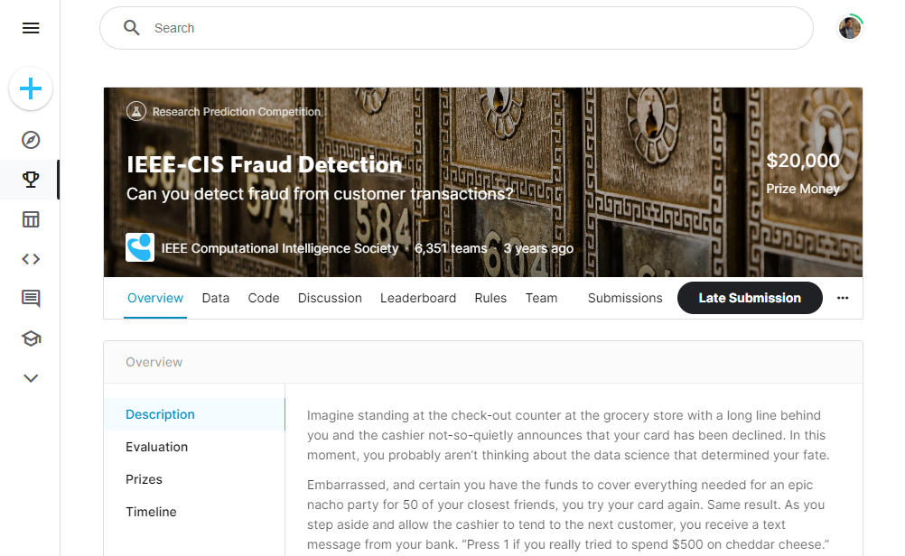
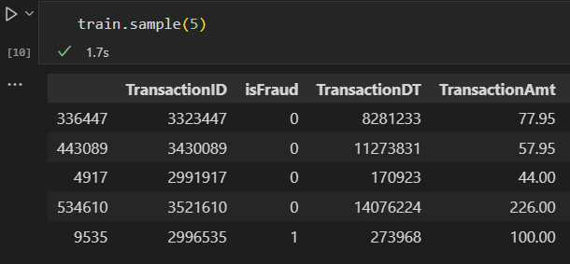
The Competition: IEEE-CIS Fraud Detection
Hosted by IEEE-CIS in 2019 to improve fraud prevention system
590K rows × 430 features for training
One record per transaction
Binary target: isFraud == 1
Our goal: Build a good NN classifier
Link to competition
Notes:
The competition: This was a Kaggle competition hosted by researchers with the IEEE Computational Intelligence Society to improve their fraud prevention system. Partnered with the world’s leading payment service company, Vesta Corporation, seeking the best solutions for fraud prevention industry. Held between between July and October 2019, a total of 6,351 teams competed for a $20,000 cash prize.
The data
The hosts provides six months of transaction-level data in a labelled set for training, and a different six months of transactions in an unlabeled test set. This comes out to 590K rows of transactions for training and 507K rows for transactions
There was a supplemental identity table but only for a subset of the transactions. We attempted to use it for feature engineering and tried to map it back to the transaction level. Eric will talk about it a bit later.
The target variable isFraud is binary, where the value 1 indicates that the transaction has been flagged for fraud.This means we are working in the domain of binary classification, but because the competition asks teams to submit predictions as raw probabilities instead of the actual zero’s and one’s we don’t end up worrying about a decision boundary.
Our goals: Build a neural network model achieving a Kaggle score that outperforms our baseline model and places (relatively) close to the competitive range

Slide 3
Available Features for Each Transaction
Group of Features | Features | Example
Basic Transaction Details | Timestamp, amount, payment card, email domains, addr1 &2 | Card level details (visa, MC) Product CD (actual product/service) Txn amount, date, etc
Card-Level Counts | C1-C14 | number of addresses are associated with the payment card
Card-Level Time Between (Unspecified) Events | D1-D15 | days between prior transactions
Card-Level Matches | M1-M9 | match, such as names on card and address, etc.
Various Vesta-Enriched Features | V1-V339 | Vesta engineered rich features, including ranking, counting, and other entity relations.
Notes:
Total 394 columns in transaction table.
Almost all of them are intentionally left vague by the competition hosts, to avoid any identification of individuals. The data is not anonymous per se, but heavily encrypted. You might notice that there’s a lot of columns to work with here. We tried doing a PCA to reduce dimensionality. (also mention that we will talk later about how we performed L2 regularization of the parameters)
Categorical features:
ProductCD
card1 - card6
addr1, addr2
P_emaildomain
R_emaildomain
M1 - M9

Slide 4

Dealing with Imbalanced Data
Fraud detection training dataset is highly imbalanced.
The training dataset consisted of 96.5% non-fraud transactions and 3.5% fraudulent transactions
A simple-majority baseline would yield a 96.5% accurate model, but would not be too good at identifying fraud.
Downsampling: Kept all frauds, and then down sampled to get the same number of random, non-fraud transactions
https://datascience.aero/predicting-improbable-part-1-imbalanced-data-problem/
Notes:
What percent of the labelled data is of the target class?
Downsampling - what we did, why, and what effect it has on model.
— Notes (CM)
Mention that we don’t want to look at accuracy, but AUC, precision, and recall instead because they are better suited for imbalanced data. AUC is especially important to use here because it’s the evaluation metric that the competition is judging submissions based on
There are arguments against using AUC when there is a large class imbalance (see here), but the competition hosts are using it for their scoring metric.
We improved our results ~2% when downsampling our training data to have a 50-50 split of fraud and non-fraudulent transactions. In this case, we do not remove any fraud rows and we only remove non-fraudulent records. (more discussed here)
We are only downsampling the training set that is used to train the model so it is well-trained on each class, but keeping the validation the same so backpropogation updates our parameters based on data as it might see when making predictions.
Eric mentioned that we might want to rerun the model

Slide 5
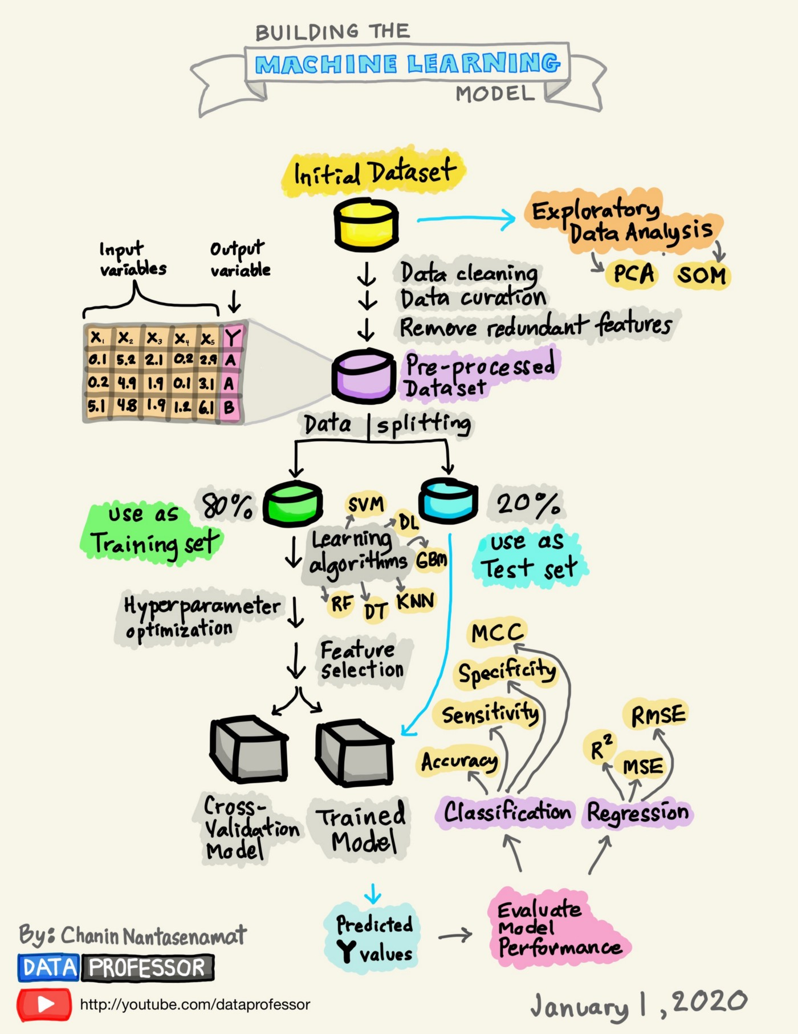
ML Model Design Process Overview
The problem: to predicting whether a given transaction is fraudulent.
EDA: Look at the feature space of more than 390 columns
Baseline Model: KNN (5)
Neural Network model:
Deeper EDA
Data processing, cleanup
Feature engineering (iterative)
Build & fit model
Notes:
– Notes NP:
Whitepapers and fraud books to understand the domain better.
A point of how we think ML is the best method to solve such a problem
Keep the graphic about an ML model design flow, if required.

Slide 6
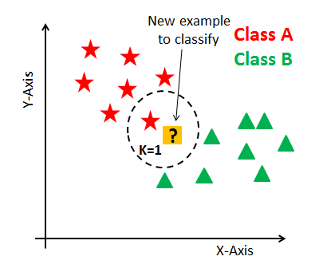
Baseline Model
Simple majority baseline model would not work due to heavy data imbalance.
We decided on using KNN model, since we theorized that fraudulent transactions could have patterns and clustering in certain features.
18 features to develop KNN model: TransactionDT, TransactionAmt, ProductCD, card1, and C1-C14
Baseline model has validation AUC of 86.9% and a Kaggle score of 82.5%
KNN Baseline Score
Public: 86.9%
Private: 82.5%
https://www.datacamp.com/tutorial/k-nearest-neighbor-classification-scikit-learn
Notes:
— Notes (NP):
Simple majority baseline wouldn’t work because of data imbalance
KNN baseline is a good baseline as it will look at the closest feature space to decide fraud or not
We used just 18 features to develop KNN model: TransactionDT, TransactionAmt, ProductCD, card1, and C1-C14
[CM] We chose to omit variables with any N/A values in the baseline, opting to deal with those in our proper model
Our rationale behind this is that there may be patterns in fraudulent transaction features, and KNN is good way to identify it
Baseline model has validation AUC of 86.9% and a public Kaggle score of 82.5%
[CM] This is our score to beat.
— Notes (CM)
Mention the hyperparameter selection of K=5 (i.e., we chose to take an average of the 5 nearest neighbors). We attempted a few values in that range, and 5 seemed to perform the best.

Slide 7

Data Pre-Processing & Feature Selection
De-anonymization
Dimensionality reduction
Limited PCA given time available and number of anonymized features
Dropped identity columns in the transaction table that weren’t providing much information
Identity table fields such as ‘browser’ and ‘OS’ mapped down to family groups
Min-max normalization
Missing values replaced for numeric values
Categorical features one-hot encoded
https://www.goodwin.edu/enews/investigator-vs-detective/
Notes:
Eric
One of the most noticeable aspects of this contest is the confidentiality of the data. we did put an extensive amount of effort into de-anonymizing as much as possible; however, in the field this would not be necessary when working for a company that's trying to detect credit card fraud on their transactions.
We did perform a limited principal component analysis given the time available and the sheer number of anonymized features, but ultimately we did use the majority of the features from the transaction table in our model with the exception of id columns that weren't necessary to uniquely identify the user.
And while we didn't use them in our final model, we applied transformations to features in the identity table such as browser and operating system to reduce the number of categories.
Some of our numerical variables are at dramatically different scales, and so to avoid over-weighting the large-scale features we apply Min-Max normalization to rescale them all within the range of 0 and 1.
To deal with our many missing values, we impute them with their respective variable’s lowest value (before applying min-max normalization). We also tried imputing with the variable’s median value, which did not change the results of the model.
We have many categorical variables, and some with sizeable amount of unique values. Accordingly, we preprocess these with one-hot encoding.

Slide 8
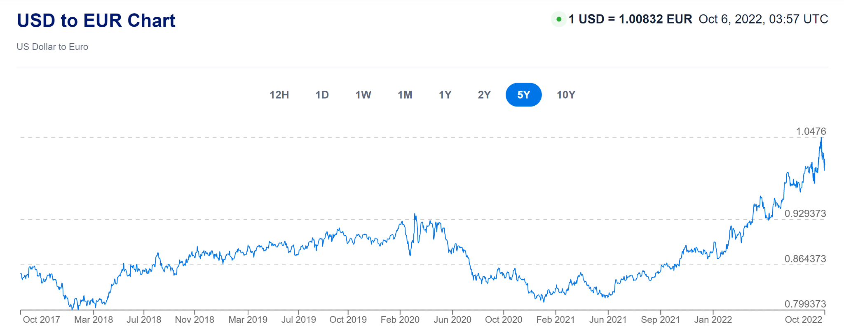
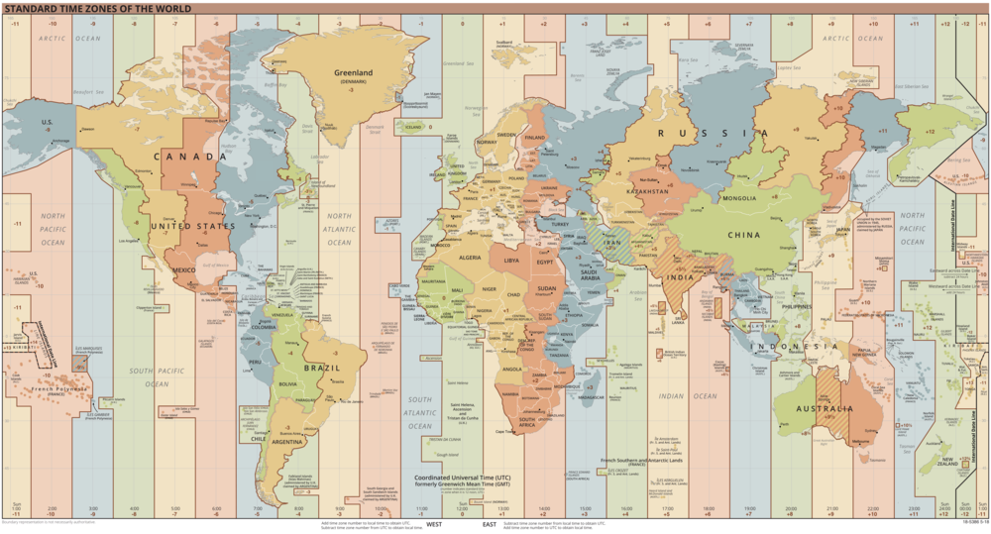
Feature Engineering
Time & location features - training data range
Top level domains for recipient and purchaser emails
Transaction in foreign currency - 3rd decimal place
Create heuristic for User ID
Filled identity table & De-anonymized features
Country - Most fraud originating from Russia and China
Timezone
Foreign currency conversion
https://www.xe.com/currencycharts/?from=USD&to=EUR&view=5Y
https://en.wikipedia.org/wiki/File:World_Time_Zones_Map.png
Notes:
Eric
We did engineer a number of features that as far as we can tell we're not explored by any of the teams in the competition that posted their code books publicly.
Based on the timing of the competition and the number and position of the transaction dates they chose to leave out, we believe we know what time frame the information is coming from which also allows us to extract additional features like day, hour, holiday, night and weekend.
In our EDA we noticed that there may be patterns in fraudulent transactions tied to email domains so we created the following features to help our model take advantage of that
Drop the domain extensions so "gmail.com" and "gmail" are placed into same group
Whether recipient, purchaser, or both email addresses are null
Whether the recipient and purchaser domain address matched (e.g., gmail to gmail)
If the recipient and purchaser domain addresses do match, what domain is it?
Transaction amounts were supplied with three decimal places and the majority were only to two decimal places, indicating that the transaction originated in US dollars; however, there is a high incidence of fraud amongst the transactions for which there is third decimal place in the amount which I'll talk more about in a second.
One of the most important features was establishing a user ID but given the anonymized data - for example last four of the credit card - that we had it was necessary to combine a number of features to arrive at the ID. Some of the columns we de-anonymized incremented with the number of transactions in a given time frame while others show transaction amounts in a given range, say the last 7 days. There were some indications that additional randomness was introduced as well as possibility of human error in labeling making it impossible to fully deanonymize so we determined it was necessary to come up with a heuristic for the ID whereby the majority of transactions could be uniquely identified by the least amount of concatenated features.
With the surrogate user ID we were able to fill in some of the incomplete information in the identity table and further deanonymize columns such as country and time zone, both of which had no mention in any of the conversations in the kaggle competition. Using these features as well as other indicators like the devices that were being used we were able to pinpoint the two countries where the majority of fraudulent activity was taking place, Russia and China.
The Russian transactions appear to be mostly in US dollars while the ones originating from China were converted to US dollars. One of our experimental features used a table of historical conversion rates that we scraped from the internet to see if the resulting US dollar amounts were originally round numbers in their local currencies. This proved difficult to implement as the currency conversion reported for that day was an average between the buy and sell price and we didn't have any information on what transaction fees were applied.

Slide 9
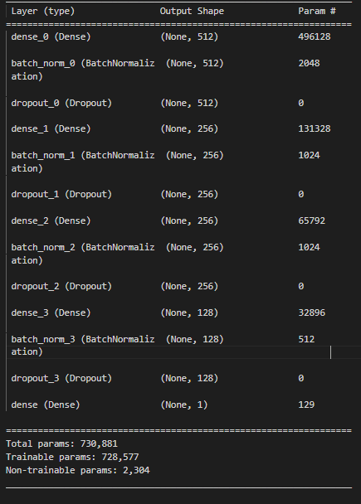

Keras Model
Final model used Keras Sequential API
4 Dense layers, each with Batch Normalization and Dropout applied
Total parameters: 730,881
We had a working functional model as well
This gave us flexibility to conduct data preprocessing within the model
We found that some Tensorflow features are hardware specific and not easily portable to accelerators
https://blog.keras.io/keras-as-a-simplified-interface-to-tensorflow-tutorial.html
Notes:
Eric
We trained our model using keras and tensorflow
Our final model was built with the keras sequential API. And the architecture we landed on had four dense layers, each with batch normalization and drop out applied for a total parameter count of over 700,000.
We were also able to successfully implement a working functional model and we noted that this came with the flexibility of conducting data preprocessing steps while the model is being built. However we didn't have a strong use case, such as a double-headed model, that justified using the functional API, and we also ran into some difficulty using accelerators because Tensorflow features can be Hardware specific.

Slide 10
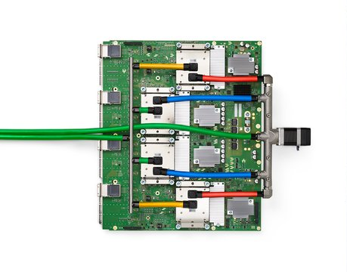
Accelerators - TPUs
We experimented with accelerators to speed up training time to allow more experimentation and larger models
Training epochs were lightning fast even with thousands of features; however, model serialization proved to be a memory intensive operation
Overall training time for a model of this size was not improved by using TPUs
Performance metrics were degraded compared to the same model architecture on a CPU, possibly due to a reduction in decimal precision
https://blog.google/technology/developers/io21-helpful-google/
Notes:
Eric
Speaking of accelerators, we did get our sequential model up and running on TPUs inside of Google Colab for the purpose of faster training time to allow more experimentation and larger models.
The actual training time while fitting the model was much faster than we anticipated; however, there were some choke points when engaging the TPU and coming out of training/predicting.
This meant that with overall training time for a model of our size it was not beneficial to use TPUs over CPUs, at least as far as time savings were concerned. We did note that when connecting to a TPU accelerator and indicating the need for a high memory machine it did seem to assign more RAM when using TPUs than would otherwise be allocated.
And additionally performance metrics were worse than on CPUs with the exact same model architecture, which we think may be due to a reduction in decimal precision.

Slide 11
Hyperparameter Tuning
Hyperparameter Type | Hyperparameter | Selection
Training and backpropagation | Loss Function and Validation Split | Binary cross-entropy w/ 10% split
 | Optimizer and Learning Rate | Adam w/ L.R. = 0.0005
 | Epochs and Batch Size | 64 epochs in batches of 1024
Hidden Layers | Hidden Layers and Nodes | [512, 256, 256, 128]
 | Activation Function | ReLU
Regularization | Model Parameters | L2 regularization w/ lambda = 0.05
 | Hidden Layers | Batch normalization and dropout at a rate of 50%
Notes:
If you recall from the async, Daniel Gillick’s insight about hyperparameter tuning is that it’s more of an art than a science. For everything you see here on the page, we reached it with a lot of tweaking to find a general Goldilocks zone, usually in terms of what improves the validation AUC.
[NEXT] We set the loss function to binary cross-entropy with a 10% validation split for backpropogation.
[NEXT] We found that 64 epochs in batches of 1024 seemed to perform the best. After trying a few optimizers and rates, we found that Adam worked well and setting the learning rate to 0.0005 was where validation loss tend to generally converge before diverging and spinning out of control.
[NEXT] We started with 2 hidden layers, which eventually grew to 4 before we stopped seeing improvements. ReLU was a reliable activation function for hidden layers and we used sigmoid for the output layer, given we’re doing binary classification.
[NEXT] Having so many features and hidden layers, we added some regularization steps and it helped with generalization. For the model parameters we include L2 regularization with a lambda of 0.05. For hidden layer nodes, we performed batch normalization and 50% dropout.

Slide 12
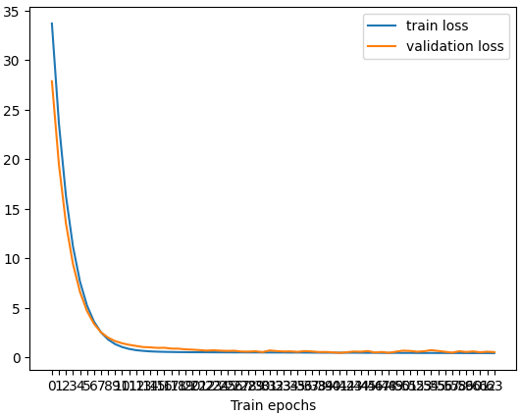
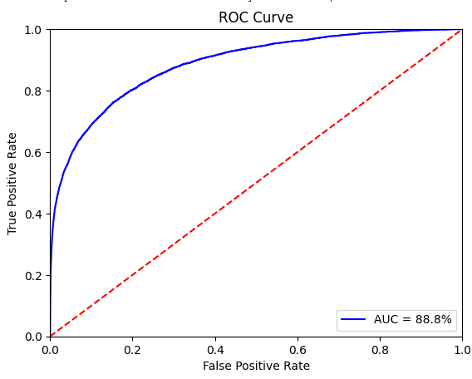
Model Performance and Results
Best Kaggle Score
Public: 87.3%
Private: 84.9%
KNN Baseline Score
Public: 86.9%
Private: 82.5%
Notes:
During training, our validation loss steeply dropped from 30 to below 1 in 16 epochs, then gradually converges to ½ by the 64th. Over those same intervals, the validation recall jumps from less than 1% to 10%, then jumps to converge at 79%.
[NEXT] We see a pretty healthy ROC curve with an area-under-the-curve of 88.8%.
[NEXT] With this model we achieved a public Kaggle score of 87.3% and 84.9% private. Compared to our baseline score, this was a modest improvement. Uri was right - sometimes a simple KNN baseline can be stubbornly good.

Slide 13
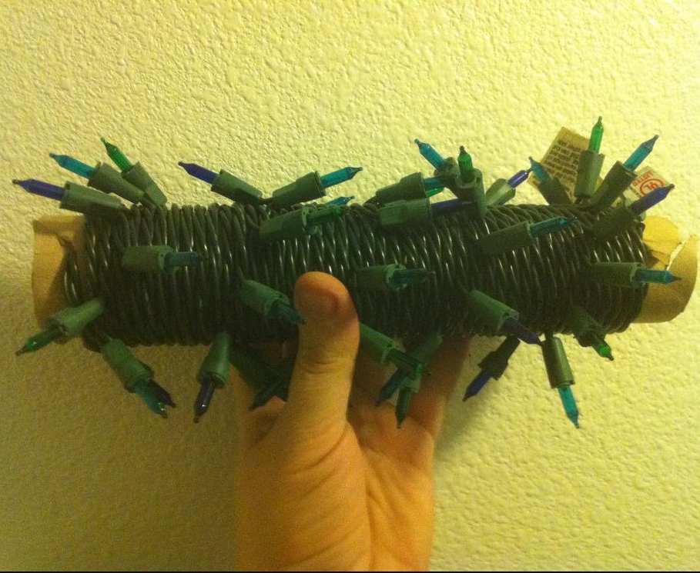
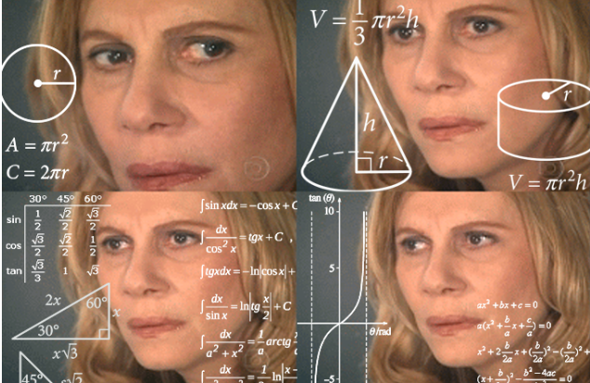
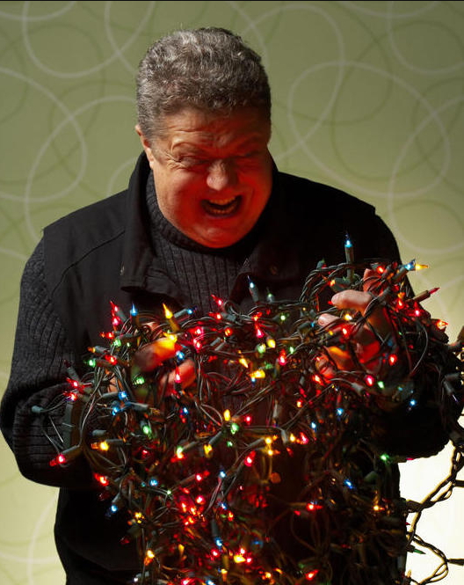
Data Generating Process for our Labels
What we expected
What we got
https://stressexterminators.wordpress.com/2015/02/10/stress-hacking-christmas-lights-organization/
Notes:
Don’t worry, the fun doesn’t end there. We made sure to do our due diligence to understand what’s going on upstream of the data we’re working with. Based on the description from Kaggle, we expected the underlying data generating process for our labels to be reasonably clean and intuitive. The Dataset Description states that we are predicting the probability that a transaction is fraudulent. In other words, we thought going into this that a card-holder checks their card history to find some unfamiliar transactions, calls their bank to report fraud, the bank flags those transactions, and the account is closed. Simple, right? Well…
[NEXT] Turns out, that was a bit naive. After looking through the competition discussion boards, we discovered that the hosts labeled not just reported chargebacks on a card as fraud but also all prior transactions within 120 days associated with the user account, or email address, or billing address. In other words, we are predicting both fraudulent and fraud-adjacent transactions, with no distinction between them. Each genuine fraud in our dataset might be paired with several to dozens of legitimate transactions that are marked fraud.
We think this is bad news for any model built for this competition if it's intended to be applied in a real business setting. But even if we just care about getting the best Kaggle score, our model discussed above bakes in a lot of noise and learn the wrong things about the features. If your credit card was in this data and you had reported fraud, then our model has no way to differentiate that fraud transaction from times you were just paying for gas or groceries the month prior.
We attempted to overcome this by re-engineering the process ourselves with the data provided.

Slide 14
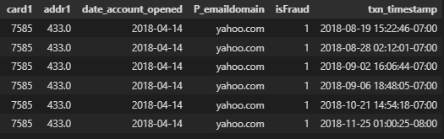
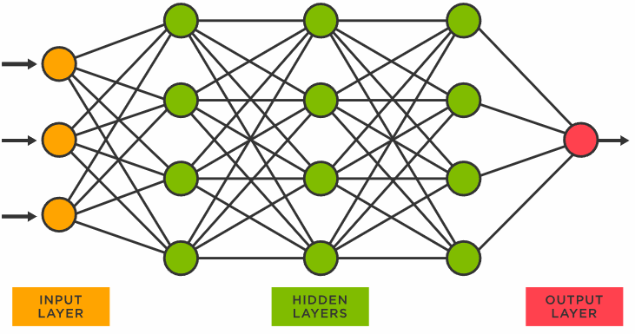
Train New Model on Latest Transaction by Card
Kaggle Score
Public: 85.9%
Private: 84.3%
Val. AUC: 85.6%
Unshrink
https://www.tibco.com/reference-center/what-is-a-neural-network
Notes:
We built a variation of the model that we trained on just the most recent transaction after grouping by the columns we think the approximates a unique card. This was messy - as we mentioned earlier in this presentation, the hosts went a long way obfuscating the data, which is probably smart considering the heavy sensitivity of the data they're sharing.
[NEXT] We grouped the user account (which are truncated to the last 4 digits), the user’s email address (which is just the domain), date the account opened (which we got by subtracting what we thought was the age of the account in days from the transaction date), and billing address (which is encoded). If you hadn’t guessed already, each of these variables contain null values and we can only get complete sets on about three-quarters of the transactions.
[NEXT] Then we dropped all but the newest record, with the assumption that the latest transaction is the one the cardholder called to report fraud on. Obviously we should be skeptical about this assumption, but that’s the best guess we have to work with.
[NEXT] With this shrunk down table containing just each card’s most recent transaction, we ran it through the same neural network described earlier, then fit that model onto a shrunk version of the test data. Now we have our predictions, and to unshrink it back up we simply left join those predictions to the full unlabelled test data by those grouping columns listed above.
[NEXT] We can now submit our predictions to Kaggle and we find that it gets a decent score considering all the problems I mentioned here. Considering that this approach was distinct from our previous model, we also wanted to try ensembling the two.

Slide 15
A Very Simple Ensembling Approach
Using Latest Transaction
Simple Average of the Two
Best Model
Kaggle Score
Public: 87.3%
Private: 84.9%
Kaggle Score
Public: 85.9%
Private: 84.3%
Kaggle Score
Public: 88.4%
Private: 86.6%
Notes:
That was a good move. By taking the simple average of each model’s predictions, our ensembled results seem to find a consensus that generalizes even better than either model individually.

Slide 16
Things we Tried, or Would Try in Future
Trial and Error
PCA dim. reduction of the 339 Vesta Features
Impute median on missing values
Log transform heavy-skewed features
Looking ahead
More feature engineering
Use just the “top 20” Vesta Features
Use more data from the identity table provided
Better approximation to identify genuine fraud and/or an ID for card
Smarter missing value imputation
Categorical embeddings - cat2vec
Notes:
[IF NO TIME]: We’ll skip this slide for time, but here we were going to mention the things we tried that just didn’t improve the model, along with things we earmarked for future things to try.
[ELSE] In addition to all the stuff we tried above, there were a few more things we tried that just didn’t pan out, or we tabled them for future work, hypothetically speaking. [read off slide from here]

Slide 17

Questions?
https://developer.confluent.io/tutorials/credit-card-activity/confluent.html
Notes:
So that was our journey through the land of fraud detection, thank you for coming along. If there’s any questions, we welcome them at this point.

Slide 18
Thank You!
Notes:
Thank you for your time time, we’ll leave it there.

